Slide 1

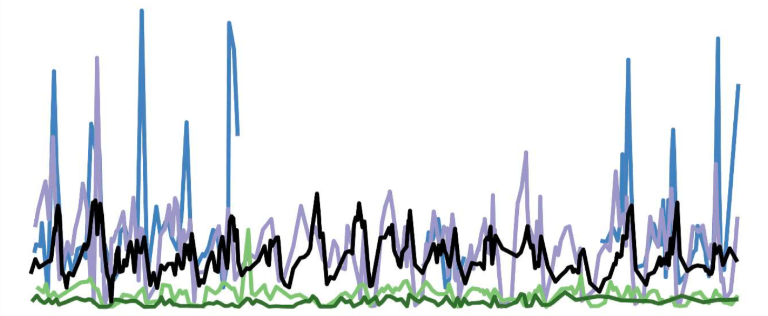
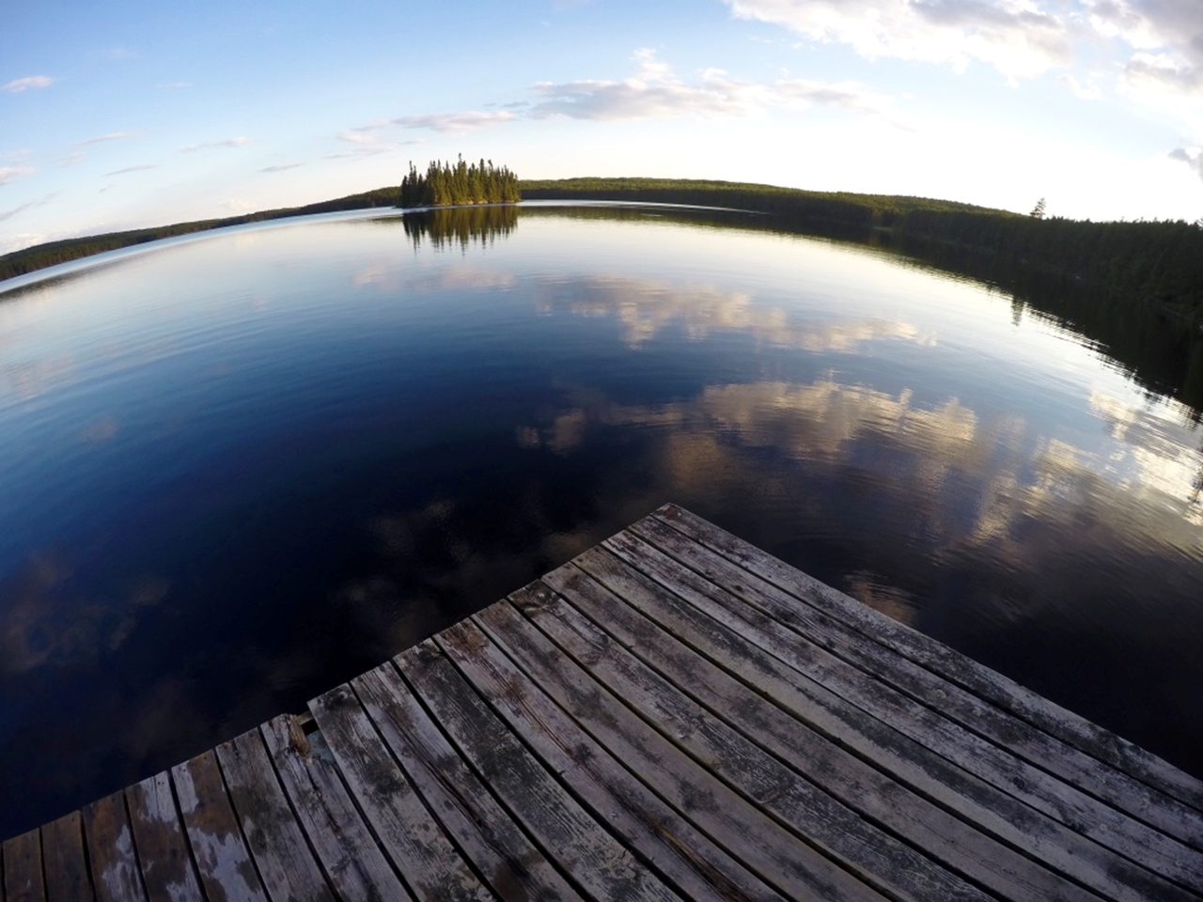
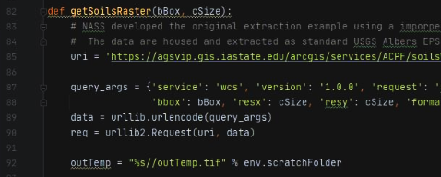
Open-Source Scripting Day 2: Geospatial data ingestion, analyses, and visualizations
September 21, 2021

Slide 2
Tetra Tech Team Brian Pickard, PhD Landscape Ecology, Geospatial Science brian.pickard@tetratech.com Kateri Salk, PhD Aquatic Ecology, Data Science kateri.salkgundersen@tetratech.com Kellie Dubay Environmental Science, Public Outreach

Slide 3
Workshop Goals
Review the current landscape of data tools & resources for water professionals
Increase familiarity with using R and Python across the data pipeline
Create and modify code for future use

Slide 4
Workshop Outline
Climate Data
Geospatial data ingestion and analysis
Hydrologic and Water Quality Data
Each Day:
Intro presentation and discussion
Hands-on demonstration
Example presentations of state applications
Hands-on demonstration

Slide 5
Ground Rules
Mute your mic unless asked to speak
Questions during sessions
During session: add your question/comment to the chat
After session: may solicit people to raise hand and turn on mic
Tech issues?
Add your issue to the chat, but may not have time to troubleshoot on the fly
Follow along on the screen, code is available for use later
Can attempt to fix issues following session or after hours

Slide 6
Day 2 Agenda
Intro: Session 2 goals, outline, logistics (30 min)
Follow ups from day 1 – Kateri, Tetra Tech
Spatial modeling introduction - Brian Pickard, Tetra Tech
Getting started with python and resources –Brian Pickard, Tetra Tech
Quick primer on land cover vs land use –Brian Pickard, Tetra Tech
Acquiring and displaying spatial data (90 min)
Break (10 min)
Examples of using land cover in modeling (45 min)
Developing ArcGIS toolbars to automate spatial preprocessing – Ansel Bubel, Florida
State of the science: Future land change models – Brian Pickard, Tetra Tech
Open-source alternatives to ESRI – Brian Pickard, Tetra Tech
Break (5 min)
Visualizing and understanding spatial outputs (45 min)
Displaying spatial model outputs – Tim Woole, US Environmental Protection Agency
Wrap-up and next day preview (15 min)

Slide 7
rnoaa issues (lcd download)
May be an API key issue
“Many functions in this package interact with the National Climatic Data Center application programming interface (API) at https://www.ncdc.noaa.gov/cdo-web/webservices/v2, all of which functions start with ncdc_. An access token, or API key, is required to use all the ncdc_ functions. The key is required by NOAA, not us. Go to the link given above to get an API key.”

Slide 8
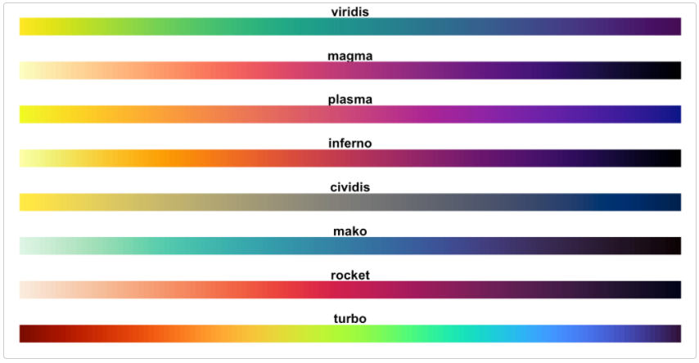
Viridis Color Palette
https://cran.r-project.org/web/packages/viridis/vignettes/intro-to-viridis.html

Slide 9
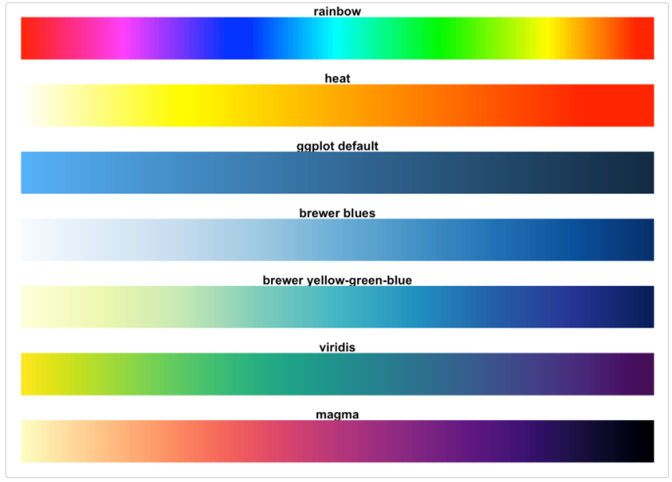
Viridis Color Palette
https://cran.r-project.org/web/packages/viridis/vignettes/intro-to-viridis.html

Slide 10
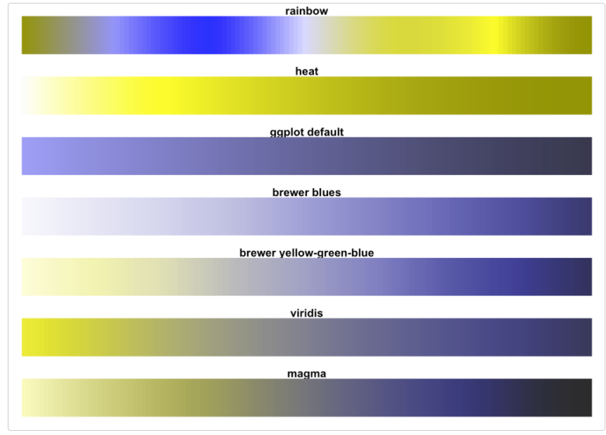
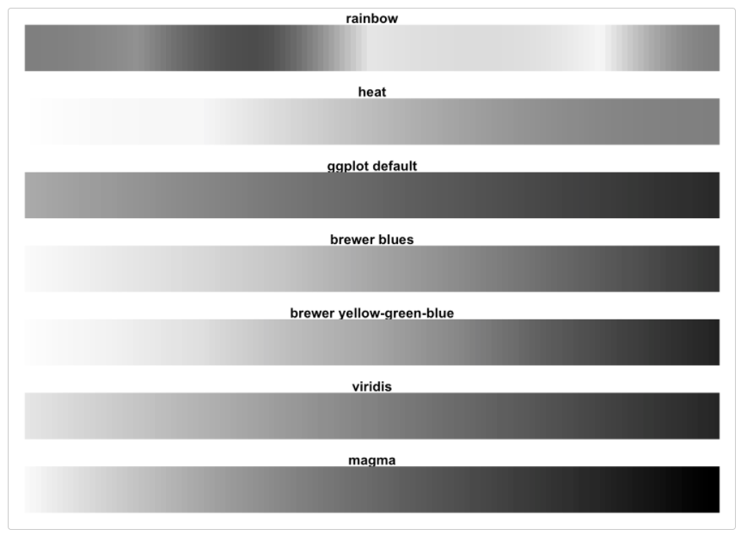
Viridis Color Palette
https://cran.r-project.org/web/packages/viridis/vignettes/intro-to-viridis.html

Slide 11
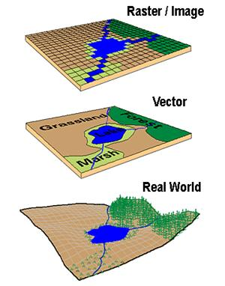
What defines a spatial model?
A model of some process operating in space (and time)
There is variation across the space (and through time)
Location is important
The results of modeling change when locations change
Locations must be known
Spatial resolution is a critical factor, it determines:
What is left out of the model
The cost of collecting data and running the model
It contributes to the model’s accuracy
Temporal resolution is important for the same reasons

Slide 12
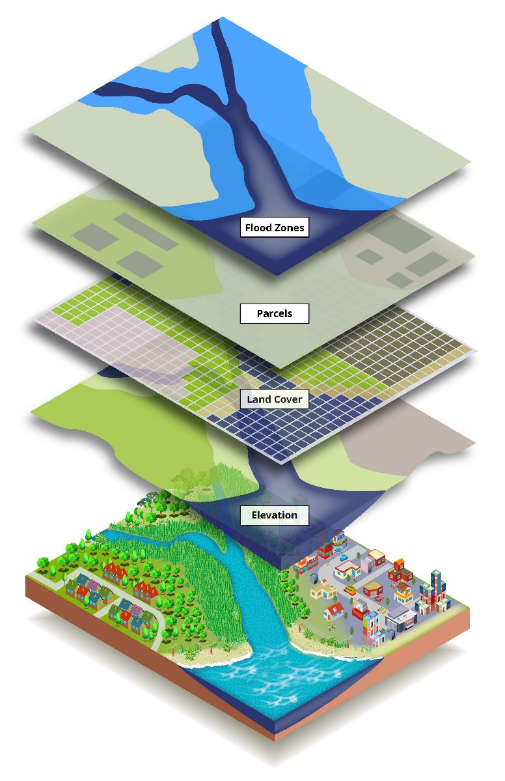
Analysis or model?
Analysis:
Static, one point in time
Searching for patterns, anomalies
Generating ideas and hypotheses
Evaluating
Modeling:
May be dynamic, multiple points in time
Implementing ideas and hypotheses
To compare to the real world
Experimenting with scenarios

Slide 13




Tools for modeling or analyzing spatial data?
ESRI products:
ArcGIS, ArcPRO ect.
Most commonly used geospatial platforms.
Pervasive throughout academia, government, and NGO sectors
Other options exist:
QGIS
GrassGIS
R options
Open-source python packages

Slide 14
Learning a new language is hard
ESRI provides tons of python related help
https://learn.arcgis.com/
Python.org has a very helpful wiki
https://wiki.python.org/moin/BeginnersGuide/Programmers
100+ links to helpful videos, tools, walkthrough’s ect

Slide 15
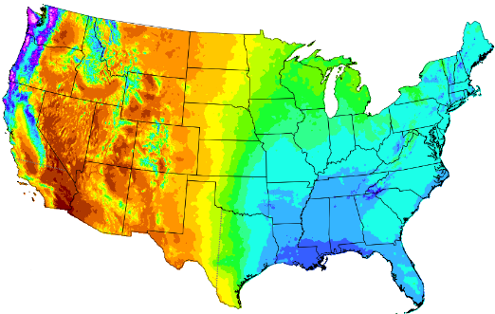
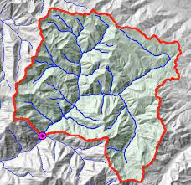
Goals for our interactive session:
1) Ingest spatial data from web sources
Example = PRISM climate data
2) Delineate and clip a watershed
Example = user defined lat/long and National Elevation Dataset
3) Aggregate spatial data to create summary statistics
Example = Summarize NLCD for watershed units (HUC12s)

Slide 16
Land cover vs land use
Land cover documents the physical conditions that occur on Earth’s surface. This includes vegetation, man-made constructions, water and bare earth.
Land use is commonly defined as a series of operations on land, carried about by humans, with the intention of obtaining products and/or benefits through land resources.

Slide 17
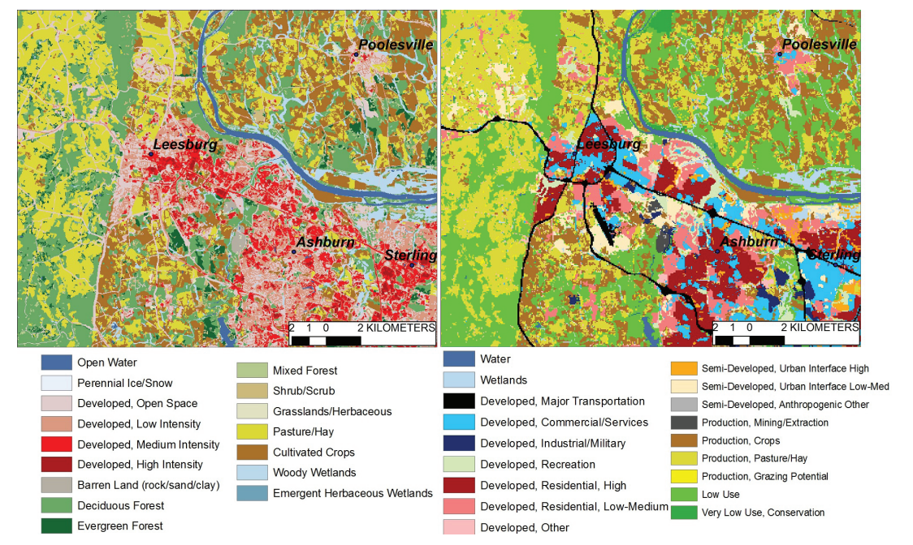
Land cover vs land use
National Land Cover Database –
https://www.mrlc.gov/
US Conterminous wall–to-wall anthropogenic land use trends
https://pubs.er.usgs.gov/publication/ds948

Slide 18
Getting started for Session 2:
github.com/KateriSalk/ACWA_OpenSourceWorkshop_2021​
Download the entire repository and save to your computer.

